Slide 1
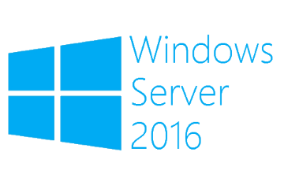
Storage Replica
Megaseries

Slide 2
Introduction
New feature in Windows Server 2016
This is a block level replication solution (not like DFSR)
Protocol used for replication is SMB 3
You can pre-seed data before initial replication
Rights can be delegated using a local group
The destination volume is not available during replication

Slide 3
Requirements
Windows Server 2016 Datacenter is needed for Storage Replica
The replication servers should have at least 2GB of RAM
You will need a volume that should be used only for logs (should only be used for this purpose)
Port 445 is needed since replication is done via SMB
The log volume should be 9GB by default (same size on both servers)
The data volumes should be the same size on both servers

Slide 4
Replication types
Synchronous replication: this is used to mirror data within a low latency network and provides crash-consistent volumes; should be used for mission critical data
Asynchronous replication: mirrors data across network links with higher latency and does not guarantee that data at the replica site will be the same as at the primary at the time of a disaster

Slide 5
Replication configurations
Stretch cluster: You can create a cluster where some nodes are located in one location and share one storage and others are in another location sharing another storage and data is replicated synchronously or asynchronously with site awareness
Cluster to cluster: Replicate data from one cluster to another synchronously or asynchronously
Server to server: Replicate data from one server to another synchronously or asynchronously

Slide 6
More info
https://docs.microsoft.com/en-us/windows-server/storage/storage-replica/storage-replica-overview

Slide 7

https://www.youtube.com/channel/UCcZ-jLbPwNr8E_v9-65n8Iw https://github.com/itknowledge4

